Slide 1
Introduction
to
Microsoft word

Slide 2
Objectives Overview
Explain Word processing software and list examples
Identify common features of word processing software
Use Microsoft word
Identify Microsoft word’s screen elements, their functions and icons
Create a new word document and format it
Save the word document created

Slide 3
Objectives Overview
Open a word document
Close a word document
Insert text
Select text
Delete text

Slide 4
What Is Word Processing?
Word processing allows you to create and edit personal and business documents, such as letters, reports, invoices, emails and books.
By default, documents saved in word are saved with the .docx extension.

Slide 5
What Is Word Processing?
Microsoft Word can be used for the following purposes −
To create business documents having various graphics including pictures, charts, and diagrams.
To store and reuse readymade content and formatted elements such as cover pages and sidebars.
To create letters and letterheads for personal and business purpose.

Slide 6
What Is Word Processing?
Microsoft Word can be used for the following purposes −
To design different documents such as resumes or invitation cards etc.
To create a range of correspondence from a simple office memo to legal copies and reference documents.

Slide 7
Getting Started Word 2019
Office 2019 is engineered for Windows 10.
You can start Word 2019 from the Start menu app list or tile area, the Start screen, or the taskbar search box.
You might also have a shortcut to Word on your desktop or on the Windows taskbar.

Slide 8
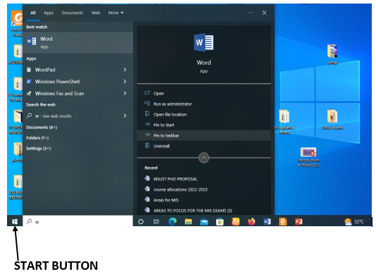
Getting Started Word 2019
Step 1 − Click the Start button and then select Microsoft Word from the options panel.

Slide 9
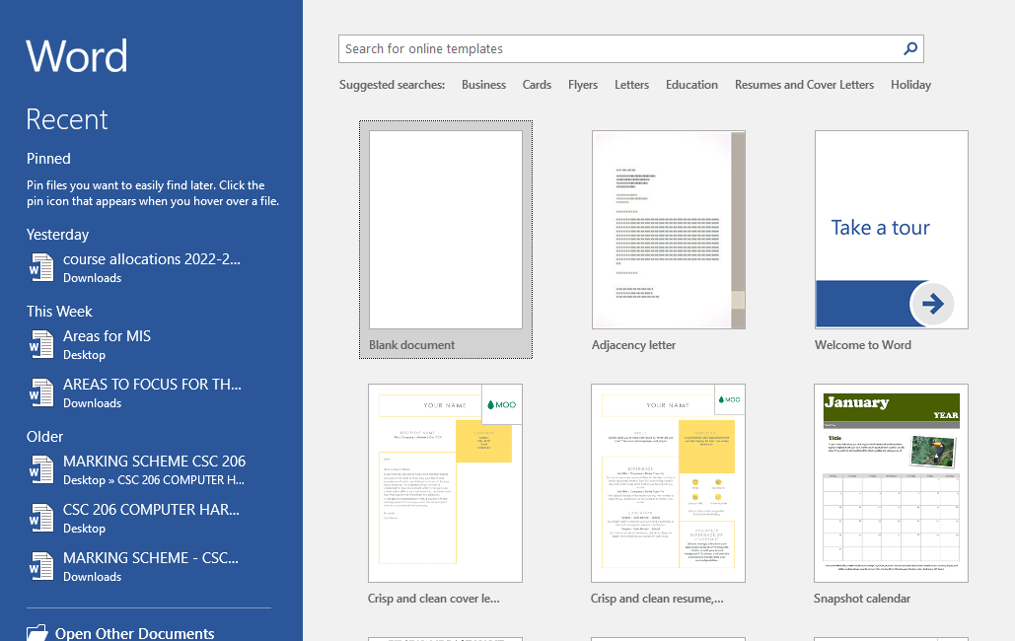
Getting Started Word 2019
Step 2 − Click on Blank document option from the menu.

Slide 10
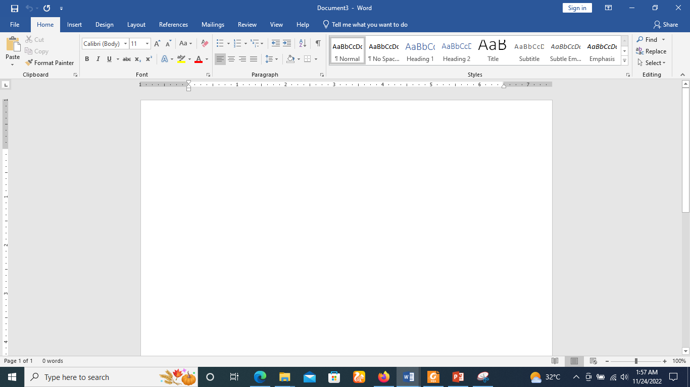
Getting Started Word 2019
This will launch the Microsoft Word 2019 application and you will see the following window.

Slide 11
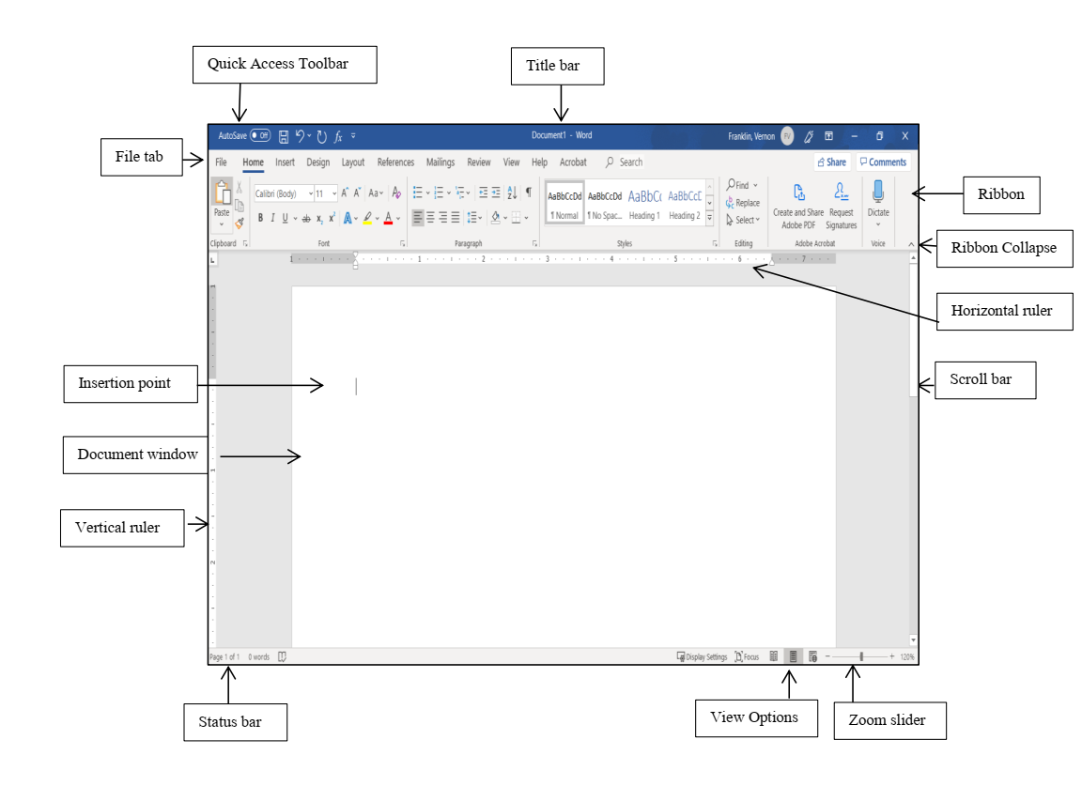
Explore Window in Word 2019

Slide 12
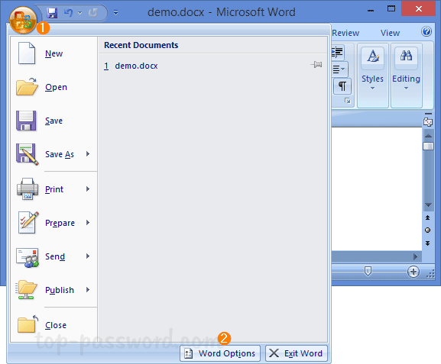
File Tab
The File tab replaces the Office button from Word 2007.
The File tab leads to the Backstage view
The Backstage view enables you to open new word file or existing word document or save files, print a document, and do other file-related operations.

Slide 13
Quick Access Toolbar
This you will find just above the File tab.
This is a convenient resting place for the most frequently used commands in Word.
By default, it shows the Save, Undo, and Redo commands
You can customize this toolbar based on your comfort.

Slide 14
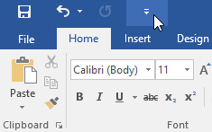
How to add new commands to the Quick Access Toolbar
Click the drop-down arrow to the right of the Quick Access Toolbar.

Slide 15
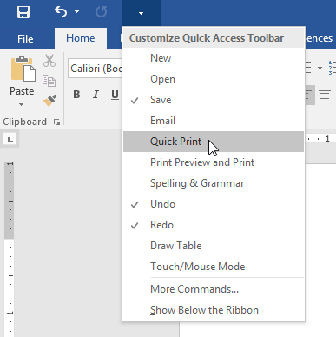
How to add new commands to the Quick Access Toolbar
Select the command (Quick print) you want to add from the menu.

Slide 16
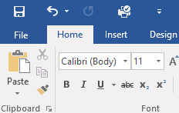
How to add new commands to the Quick Access Toolbar
The command will be added to the Quick Access Toolbar.

Slide 17
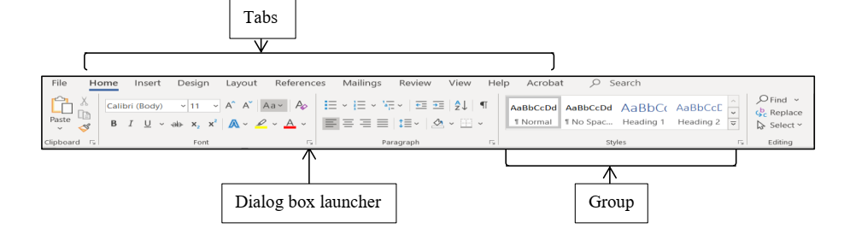
Ribbon

Slide 18
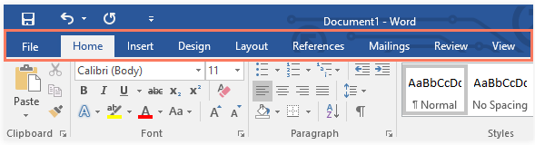
Ribbon
Ribbon contains commands organized in three(3) components −
Tabs − These appear across the top of the Ribbon and contain groups of related commands. Home, Insert, Design Layout are examples of ribbon tabs.

Slide 19
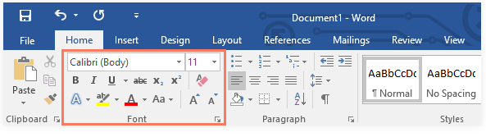
Ribbon
Ribbon contains commands organized in three(3) components −
Groups − Each tab contains several groups of related commands. For example, the Font group on the Home tab contains commands for formatting text in your document.

Slide 20
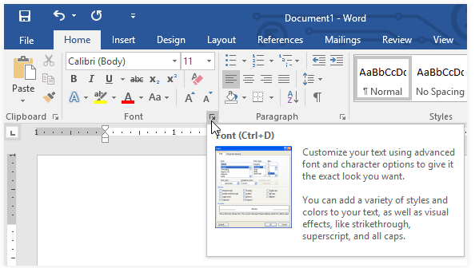
Ribbon
Ribbon contains commands organized in three(3) components
Commands − Commands appear within each group as mentioned above. Example bold, italics, cut, paste and many more.
Some groups also have a small arrow in the bottom-right corner called the dialog box launcher that you can click for even more options.

Slide 21
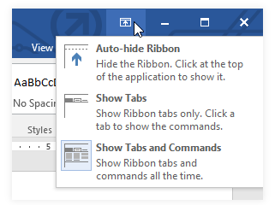
Showing and hiding the Ribbon
If you find that the Ribbon takes up too much screen space, you can hide it.
To do this, click the Ribbon Display Options arrow in the upper-right corner of the Ribbon, then select the desired option from the drop-down menu:

Slide 22
Showing and hiding the Ribbon
Auto-hide Ribbon: Auto-hide displays your document in full-screen mode and completely hides the Ribbon from view. To show the Ribbon, click the Expand Ribbon command at the top of screen.
Show Tabs: This option hides all command groups when they're not in use, but tabs will remain visible. To show the Ribbon, simply click a tab.
Show Tabs and Commands: This option maximizes the Ribbon. All of the tabs and commands will be visible. This option is selected by default when you open Word for the first time.

Slide 23
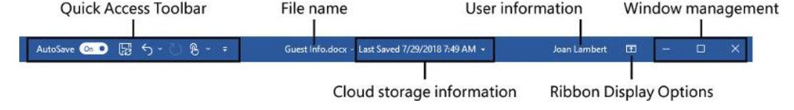
Title bar
Located at the top of the app window, the title bar displays the name of the active document and provides tools for managing the app window, ribbon, and content.
By default the title bar is always named as document 1
Title bar shows the program and document titles.

Slide 24
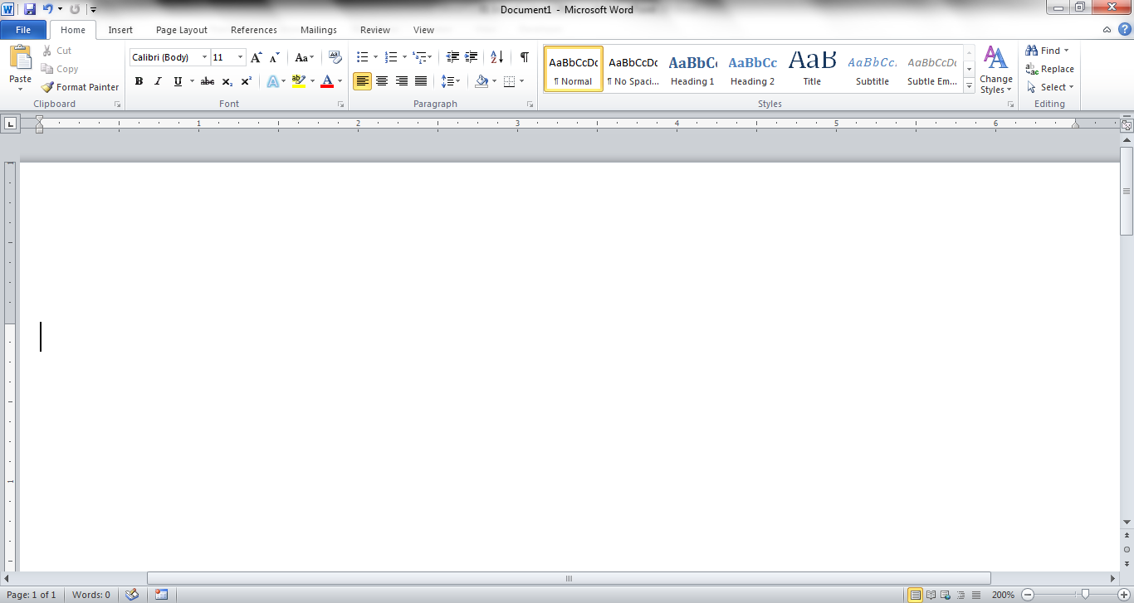
The area outlined in red contains the minimize, maximize/restore and close buttons for the program window.

Slide 25
These three buttons are on almost every window that opens in a Windows based platform.
They are on Mac windows as well, but they are circles instead of squares.

Slide 26
When you click the minimize button the program becomes a button on the Windows taskbar located at the bottom of the screen.

Slide 27
You can restore the document to its original shape and size by either:
Clicking on the button on the task bar one time to restore it to active mode,

Slide 28
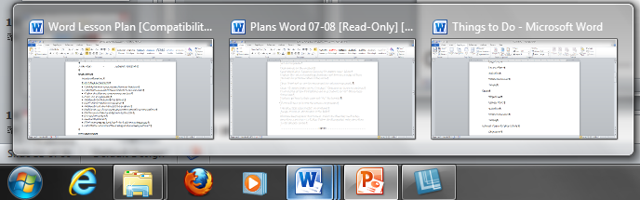
If you have multiple files from the same program open you will need to select the one you want to restore to active mode. The shortcut for this is ALT + Tab

Slide 29
When you click the maximize / restore button the program assumes the same shape and size it was before you minimized it.
Or
The program window will fill the screen.

Slide 30
When you click the close button the program will ask you if you want to save the changes, if you have made any changes. Once you have responded to this question the program will close.

Slide 31
Rulers
Word has two rulers - a horizontal ruler and a vertical ruler.
The horizontal ruler appears just beneath the Ribbon and is used to set margins and tab stops.
The vertical ruler appears on the left edge of the Word window and is used to gauge the vertical position of elements on the page.

Slide 32
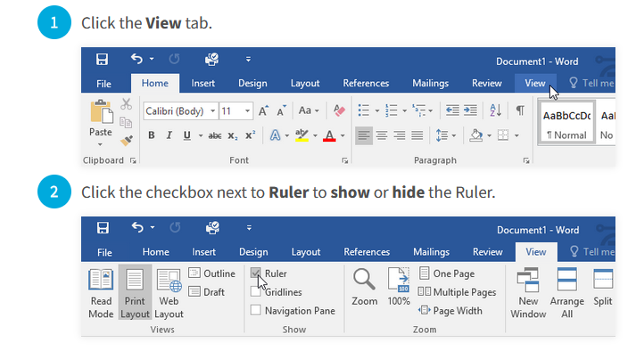
To show or hide the Ruler

Slide 33
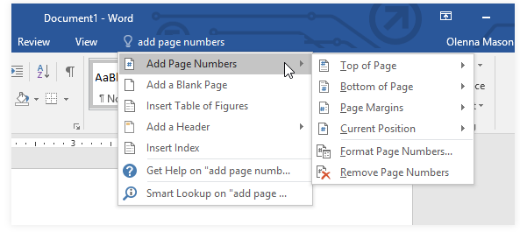
Using the Tell me feature
If you're having trouble finding a command you want, the Tell Me feature can help. It works just like a regular search bar. Type what you're looking for, and a list of options will appear. You can then use the command directly from the menu without having to find it on the Ribbon.

Slide 34
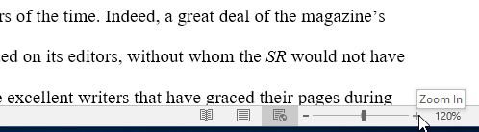
Zoom Control
The zoom control consists of a slider that you can slide left or right to zoom in or out; you can click the + buttons to increase or – button to decrease the zoom factor.
To zoom in or out, click and drag the zoom control slider in the bottom-right corner of the Word window.
The number next to the slider displays the current zoom percentage, also called the zoom level.

Slide 35
Document views
You can choose to view your document in Read Mode, Print Layout, or Web Layout.
Switching between different document views is easy.
Just locate and select the desired document view command in the bottom-right corner of the Word window.

Slide 36
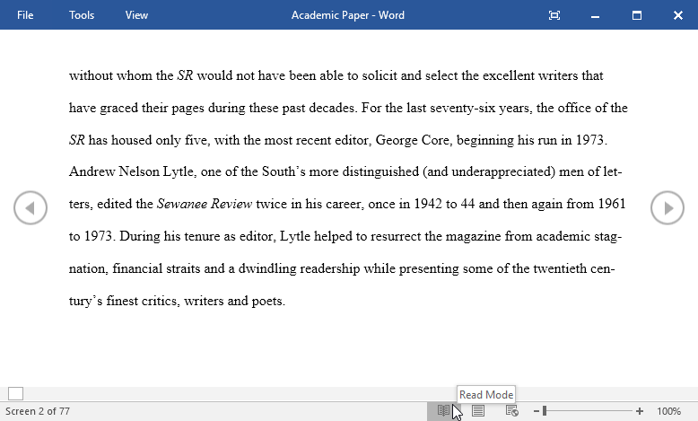
Switching document views
Read Mode: This view opens the document to a full screen. This view is great for reading large amounts of text or simply reviewing your work.

Slide 37
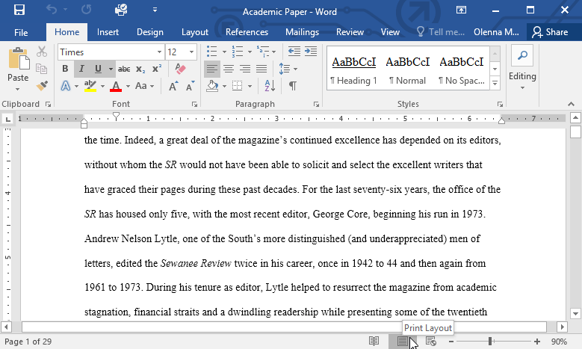
Switching document views
Print Layout: This is the default document view in Word. It shows what the document will look like on the printed page.

Slide 38
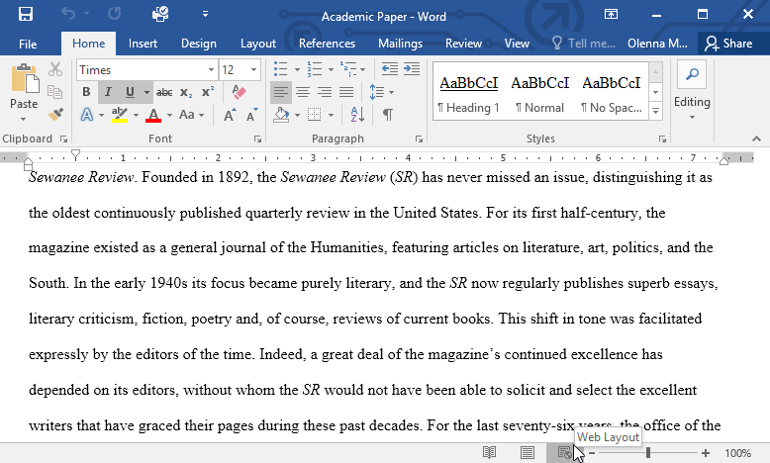
Switching document views
Web Layout: This view displays the document as a webpage, which can be helpful if you're using Word to publish content online.

Slide 39
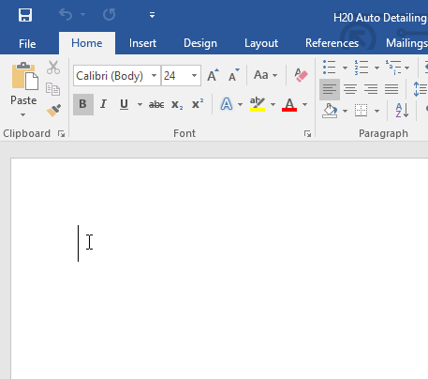
Document Area
This is the area where you type.
The flashing vertical bar is called the insertion point and it represents the location where text will appear when you type.
When a new blank document opens, the insertion point will appear in the top-left corner of the page.

Slide 40
Status Bar
This displays the document information as well as the insertion point location.
From left to right, this bar contains the total number of pages and words in the document, language, etc.
You can configure the status bar by right-clicking anywhere on it and by selecting or deselecting options from the provided list.

Slide 41
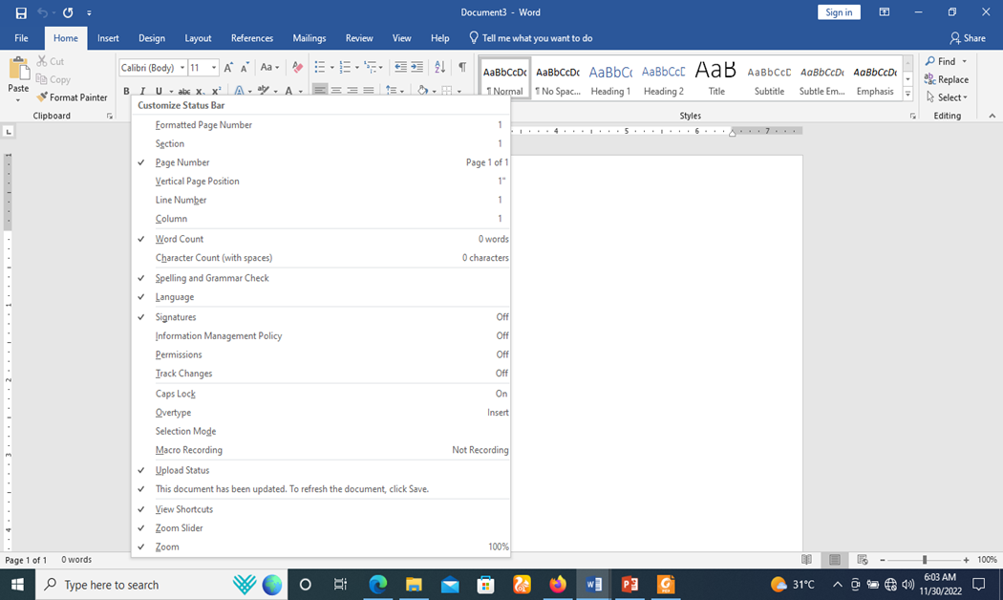
Configuring the Status Bar

Slide 42
Backstage View in Word 2019
This acts as the central place for managing your documents.
The backstage view helps in creating new documents, saving and opening documents, printing and sharing documents, and so on.
Getting to the Backstage View is easy: Just click the File tab, located in the upper-left corner of the Word Ribbon.

Slide 43
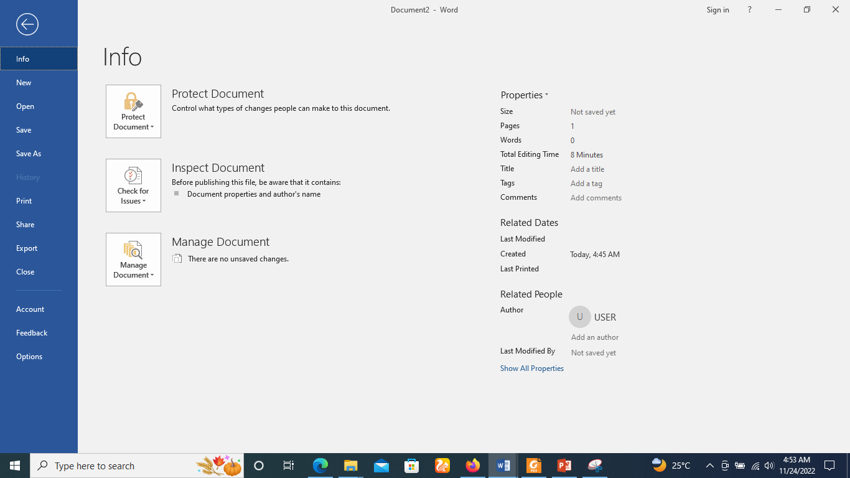
Backstage View in Word 2019

Slide 44
Entering Text - Microsoft Word 2019
Document area is the area where you type your text.
The flashing vertical bar is called the insertion point and it represents the location where the text will appear when you type.
keep the cursor at the text insertion point and start typing the text. We typed only two words "Hello Word" as shown below.

Slide 45
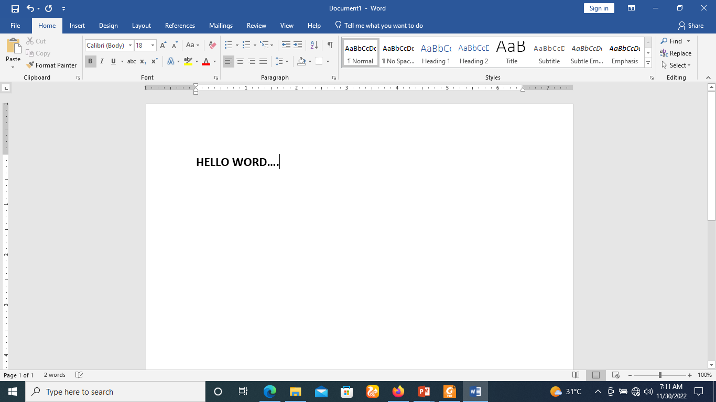
Entering Text - Microsoft Word 2019

Slide 46
Move Around in Word 2019
To begin with, let us create some sample text.
To create a sample text, there is a short cut available.
Open a new document and type =rand() and press Enter. Word will create the following content for you.

Slide 47
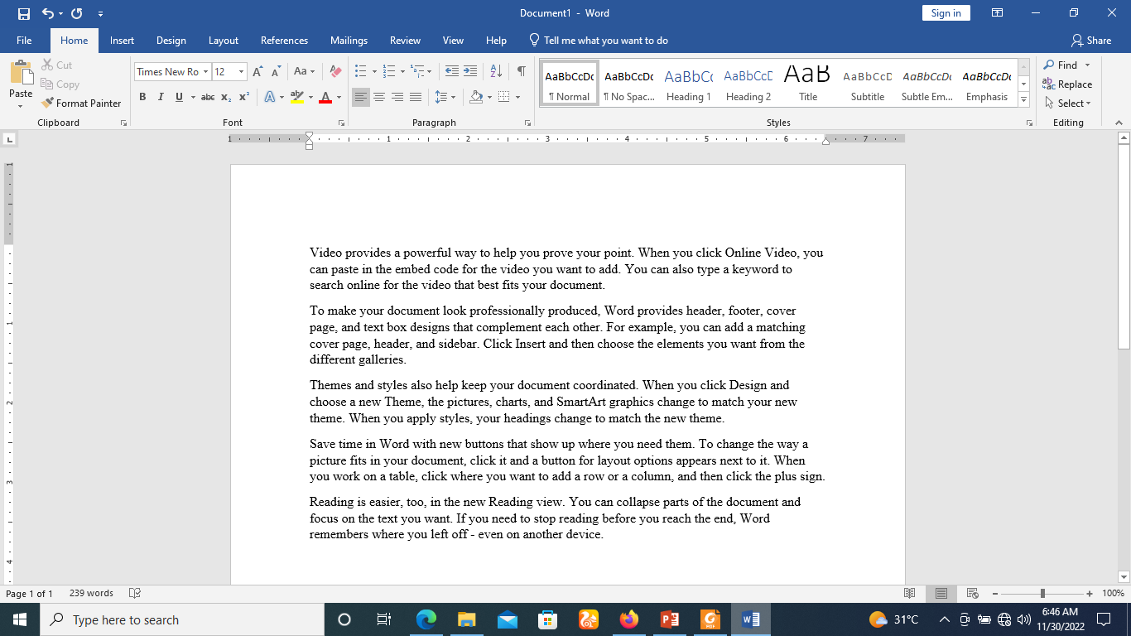
Move Around in Word 2019

Slide 48
Moving with Mouse
You can easily move the insertion point by clicking in your text anywhere on the screen.
There may be instances when a document is voluminous and you cannot see a place where you want to move.
Here, you will have to right click on the scroll bar to help you move top, bottom of the page, as shown in the following screenshot −

Slide 49

Move Around in Word 2019

Slide 50
Save and Save As
Word offers two ways to save a file: Save and Save As. These options work in similar ways, with a few important differences.
Save: When you create or edit a document, you'll use the Save command to save your changes. You'll use this command most of the time. When you save a file, you'll only need to choose a file name and location the first time. After that, you can click the Save command to save it with the same name and location.
Save As: You'll use this command to create a copy of a document while keeping the original. When you use Save As, you'll need to choose a different name and/or location for the copied version.

Slide 51
Save Document in Word 2019
It's important to save your document whenever you start a new project or make changes to an existing one.
Saving early and often can prevent your work from being lost.
You'll also need to pay close attention to where you save the document so it will be easy to find later.

Slide 52
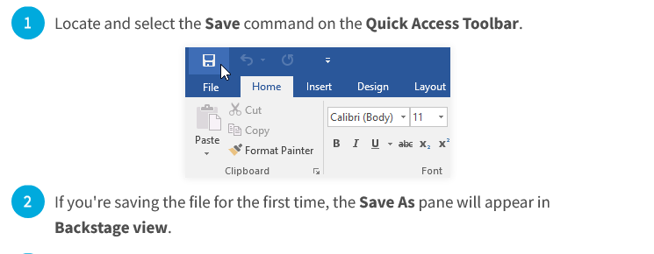
Save Document in Word 2019

Slide 53
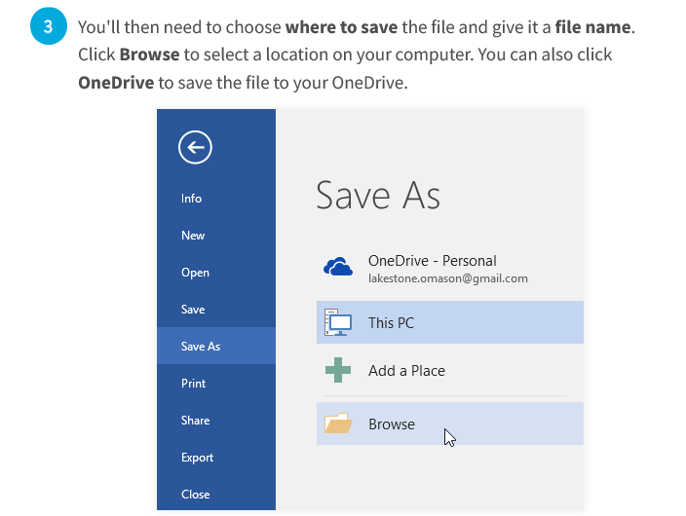
Save Document in Word 2019

Slide 54
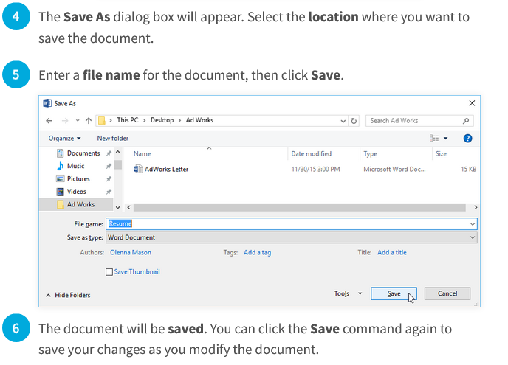
Save Document in Word 2019

Slide 55
Using Save As to make a copy
You can also access the Save command by pressing Ctrl+S on your keyboard.
If you want to save a different version of a document while keeping the original, you can create a copy.
For example, if you have a file named Sales Report, you could save it as Sales Report 2 so you'll be able to edit the new file and still refer back to the original version.

Slide 56
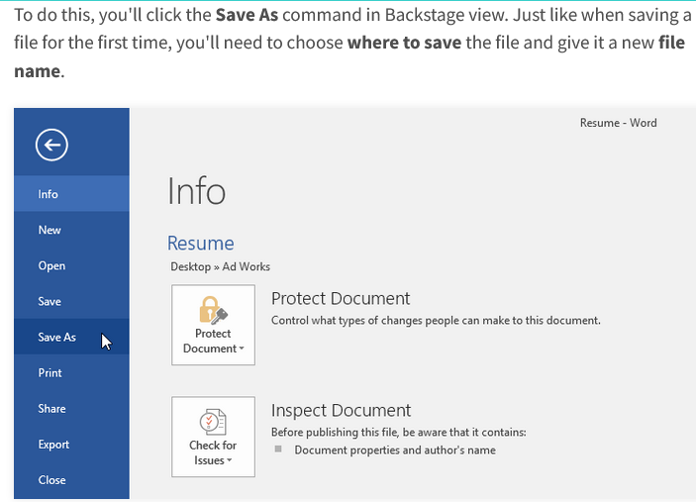
Using Save As to make a copy

Slide 57
AutoRecover in Word 2019
Word automatically saves your documents to a temporary folder while you are working on them.
If you forget to save your changes or if Word crashes, you can restore the file using AutoRecover.
By default, Word autosaves every 10 minutes. If you are editing a document for less than 10 minutes, Word may not create an autosaved version.

Slide 58
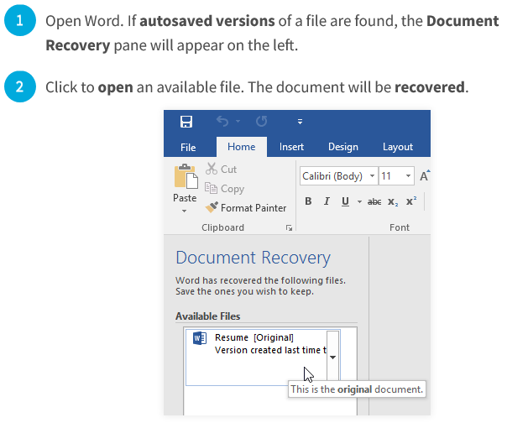
To use AutoRecover

Slide 59
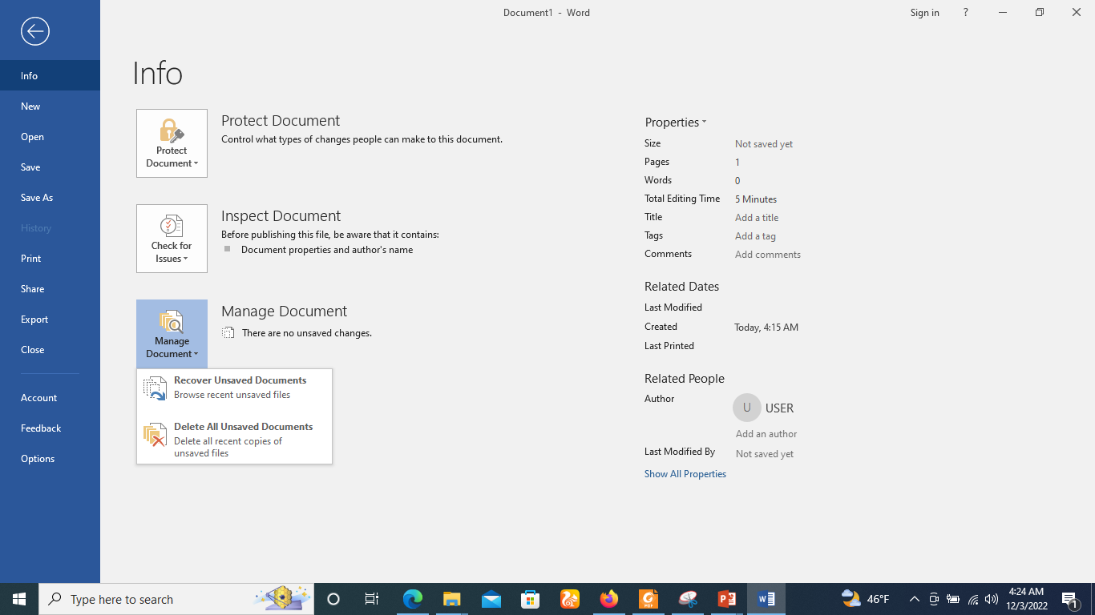
To use AutoRecover
If you don't see the file you need, you can browse all autosaved files from Backstage view.
Select the File tab, click on the info tab, click on Manage document, then choose Recover Unsaved Documents.

Slide 60
Exporting documents in Word 2019
By default, Word documents are saved in the .docx file type.
However, there may be times when you need to use another file type, such as a PDF or Word 97-2003 document.
It's easy to export your document from Word to a variety of file types.

Slide 61
Exporting documents as a PDF file in Word 2019
Exporting your document as an Adobe Acrobat document, commonly known as a PDF file, can be especially useful if you're sharing a document with someone who does not have Word.
A PDF file will make it possible for recipients to view—but not edit—the content of your document.

Slide 62
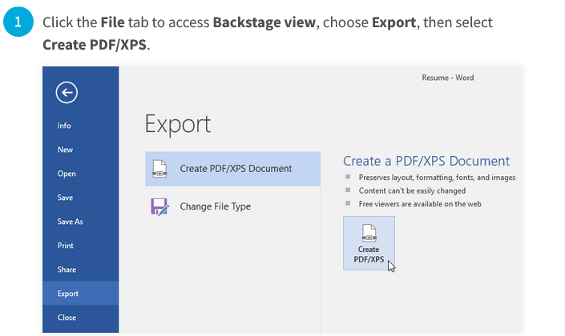
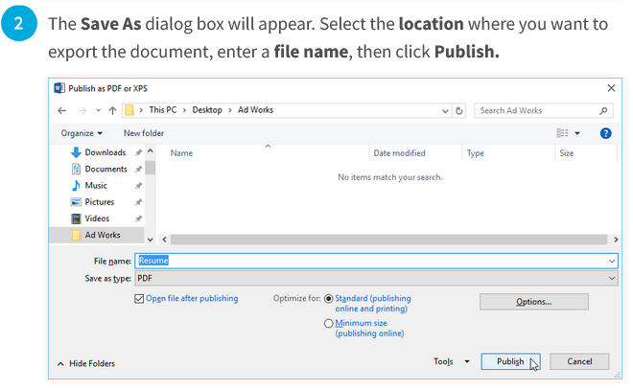
Exporting documents as a PDF file in Word 2019

Slide 63
Exporting documents to other file types in Word 2019
You may also find it helpful to export your document to other file types, like a Word 97-2003 Document if you need to share with people using an older version of Word or a .txt file if you need a plain-text version of your document.

Slide 64
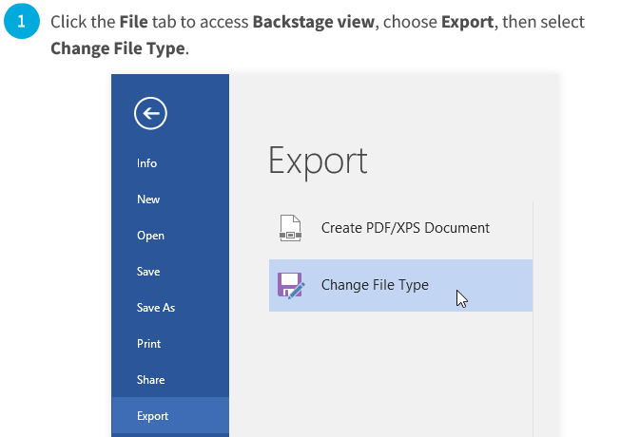
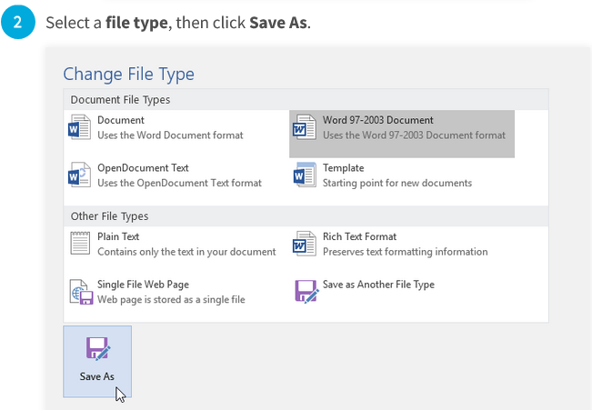

Exporting documents to other file types in Word 2019

Slide 65
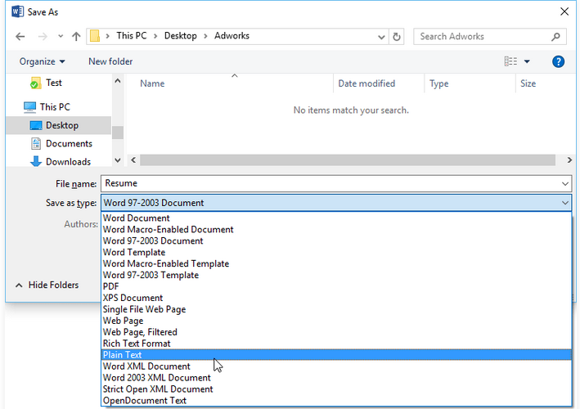
Exporting documents to other file types in Word 2019
You can also use the Save as type drop-down menu in the Save As dialog box to save documents to a variety of file types.

Slide 66
Opening a Document in Word 2019
A new, blank document always opens when you start Microsoft Word.
Suppose you want to start another new document while you are working on another document, or you closed an already opened document and want to start a new document.

Slide 67
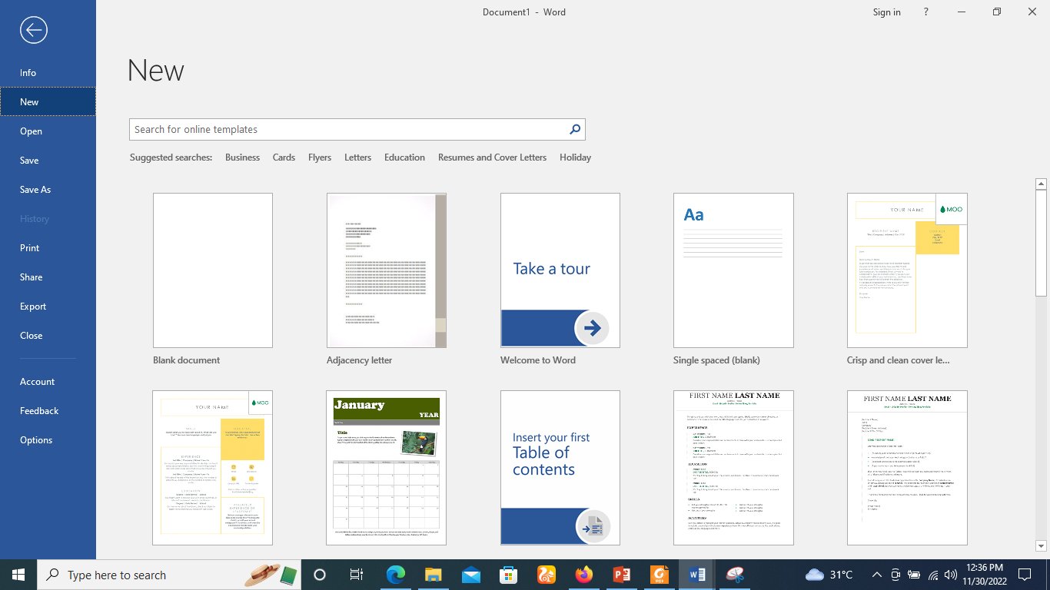
Opening a Document in Word 2019
Step 1 − Click the File tab and select the New option.

Slide 68
Opening a Document in Word 2019
Step 2 − When you select the New option from the first column, it will display a list of templates in the second column.
Double-click on the Blank document; this is the first option in the template list.

Slide 69

Opening a Document in Word 2019

Slide 70
Opening a Document in Word 2019
You can use a shortcut to open a blank document anytime.
Try using the Ctrl + N keys and you will see a new blank document similar to the one in the above screenshot.

Slide 71
Opening Existing Document
There may be a situation when you open an existing document and edit it partially or completely. Follow the steps given below to open an existing document
Step 1 − Click the File tab and select the Open option.

Slide 72
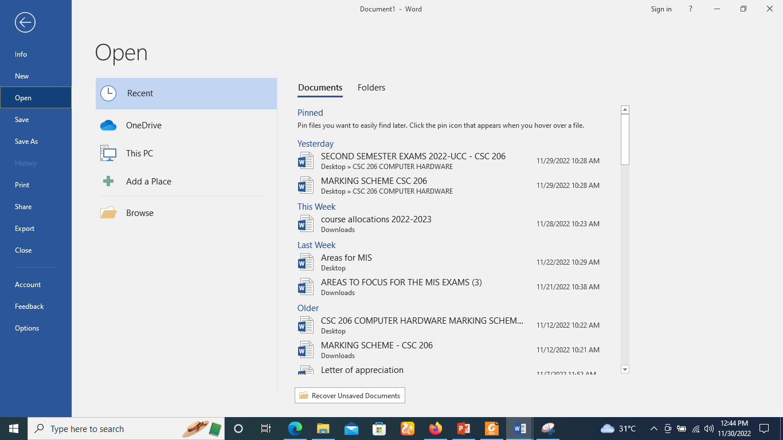
Opening Existing Document

Slide 73
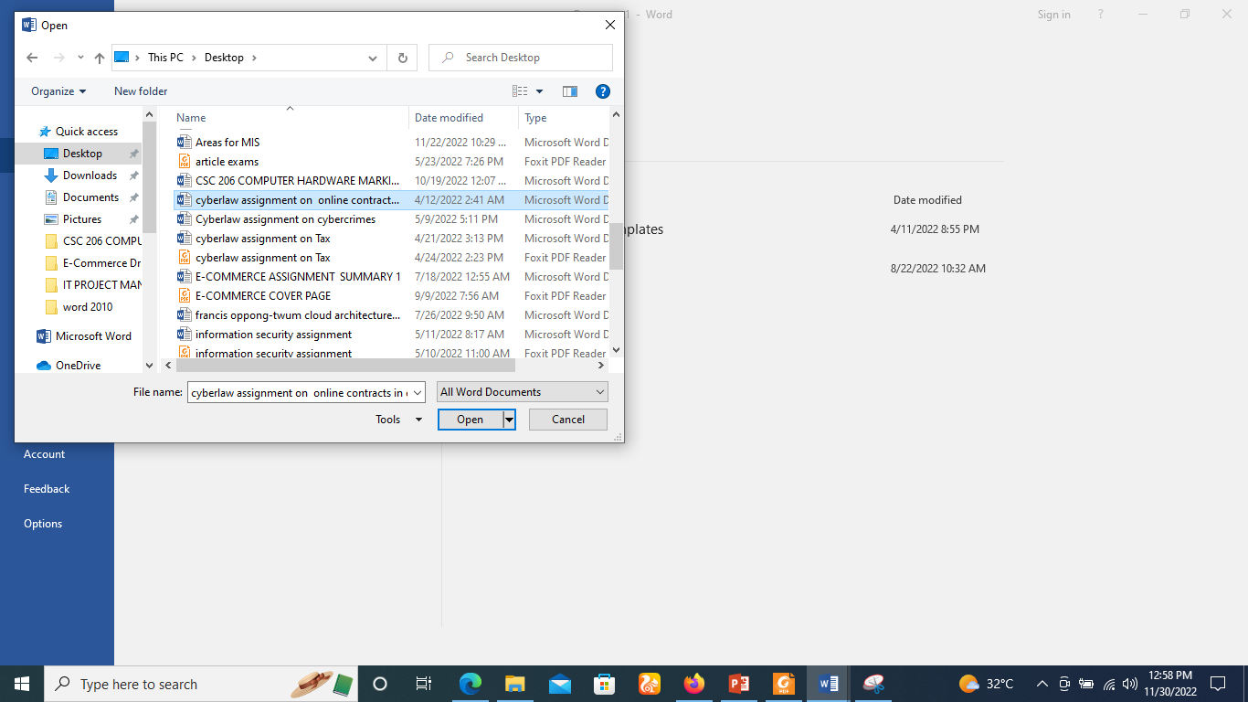
Opening Existing Document
Step 2 − This will display the following file Open dialog box.
This lets you navigate through different folders and files, and also lets you select a file which you want to open.

Slide 74
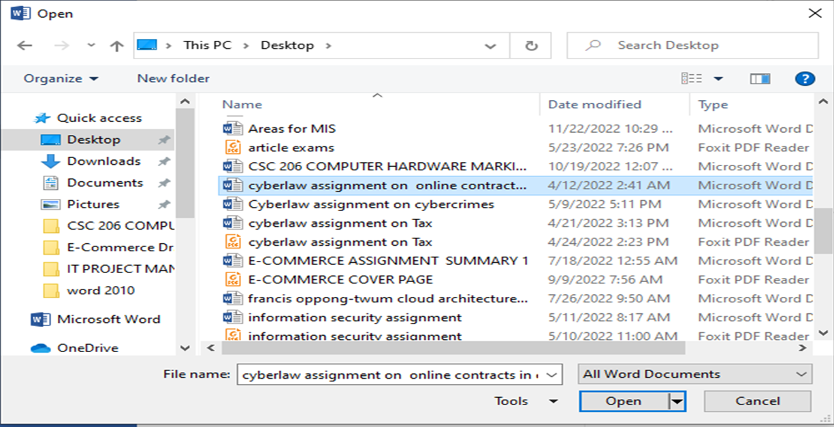
Opening Existing Document
Step 3 − Finally, locate and select a file which you want to open and click the small triangle available on the Open button to open the file.
You will have different options to open the file, but simply use the Open option.

Slide 75

Closing a Document in Word 2019
Step 1 − Click the File tab and select the Close option.

Slide 76
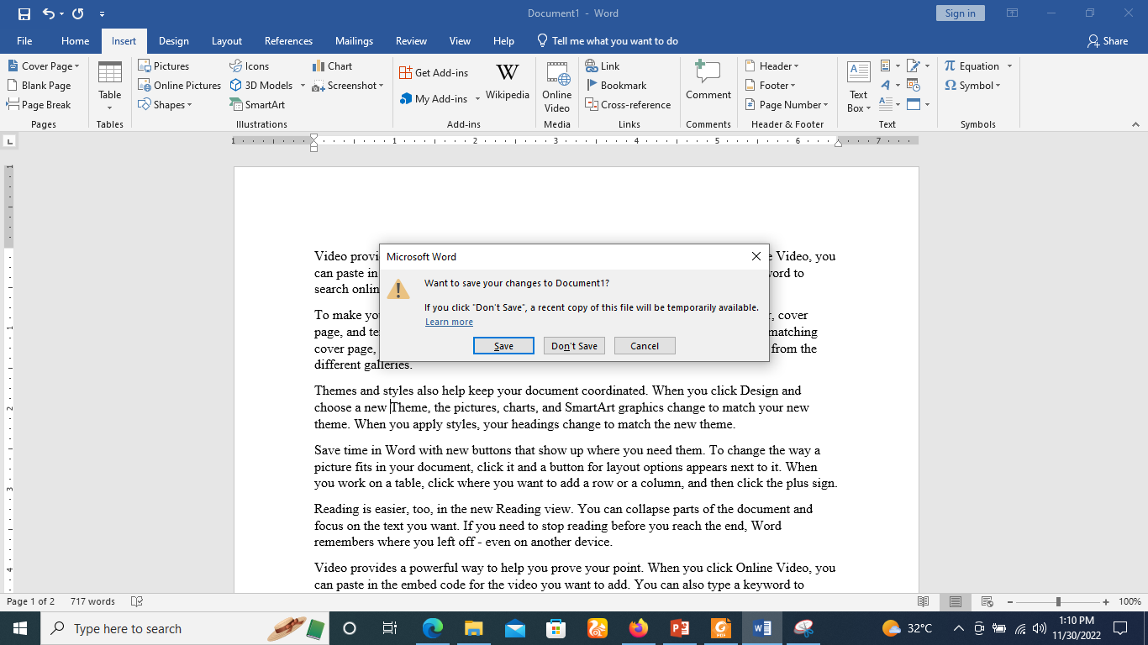
Closing a Document in Word 2019
Step 2 − When you select the Close option and if the document is not saved before closing, it will display the following Warning box asking whether the document should be saved or not.

Slide 77
Closing a Document in Word 2019
Step 3 −
To save the changes, click Save,
Otherwise click Don't Save.
To go back to the document, click Cancel. This will close the document and if you have other documents open, Word displays the last document you used, otherwise, you see a blank Word window as shown below −

Slide 78
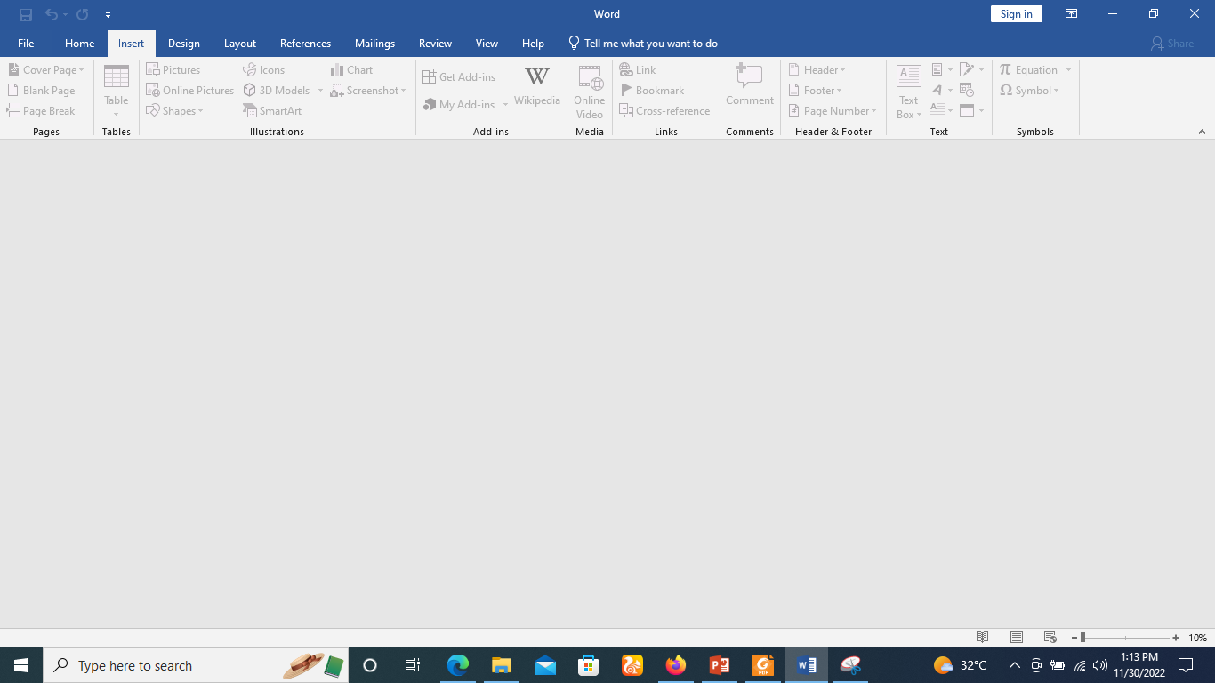
Closing a Document in Word 2019

Slide 79


Slide 80
THANK YOU

